Slide 1
Dimension reduction
Lee-Ad Gottlieb

Slide 2
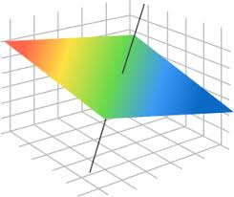
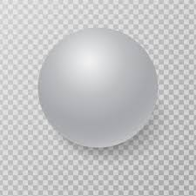
High dimension is bad!
For learning
High dimensional objects (hyperplanes, balls) have high VC-dimension.
Nets have VC-dimension exponential in d
So sample will need to be large
For computational tasks
Many tasks have runtimes that increase exponentially in the dimension
Ex: exact nearest neighbor

Slide 3
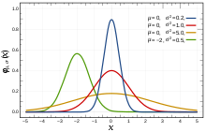
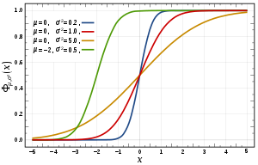
Curse of dimensionality
Curse of dimensionality (Bellman, 1961)
Task: Estimating probability distribution functions
Probability density function
Cumulative distribution function
Probability mass function
Problem:
Solution complexity
and required memory
grow exponentially with the dimension.

Slide 4
High dimension
High dimension might also be unnecessary
Suppose we took 1000 measurements of a person’s body.
Most of these measurements will be correlated
Can guess them without measuring
Johnson & Lindenstrauss (1984)
Fundamental result in dimension reduction
Given n points in high dimension
Can reduce the dimension to logn without affecting distances much

Slide 5
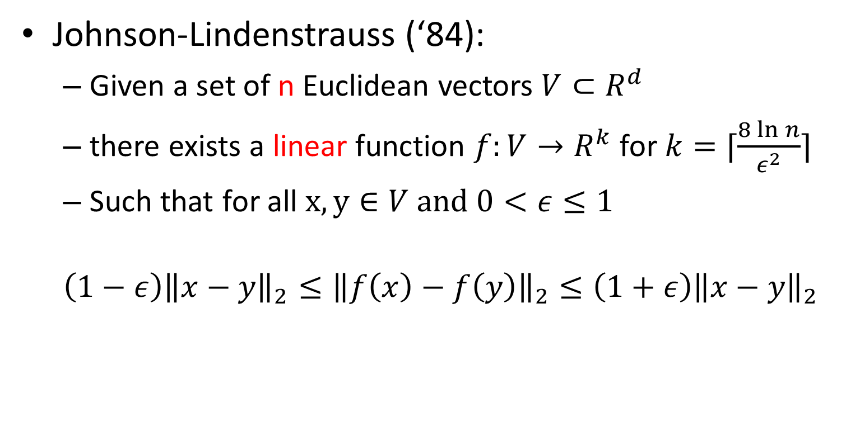
JL Lemma
Johnson-Lindenstrauss (‘84):
Given a set of n Euclidean vectors $V⊂R^{d}$
there exists a linear function $f:V→R^{k}$ for $k=⌈\frac{8\ln{n}}{ε^{2}}⌉$
Such that for all $x,y∈V$ and $0<ε≤1$
$$\left(1−ε\right){\left\|x−y\right\|}_{2}≤{\left\|f\left(x\right)−f\left(y\right)\right\|}_{2}≤\left(1+ε\right){\left\|x−y\right\|}_{2}$$

Slide 6
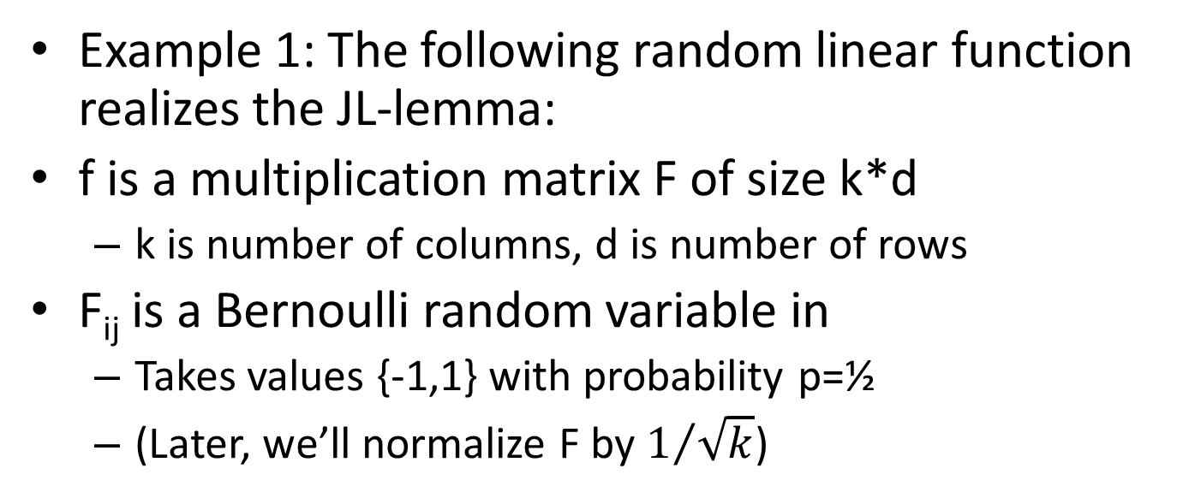
JL transform
Example 1: The following random linear function realizes the JL-lemma:
f is a multiplication matrix F of size k*d
k is number of columns, d is number of rows
F_{ij} is a Bernoulli random variable in
Takes values {-1,1} with probability p=½
(Later, we’ll normalize F by $1/{\sqrt{k}}$)
x
F
f(x)
-1 | 1
1 | -1
1 | 1
-1 | 1
(8, 1, 6, 3)
= (-4, 16)

Slide 7
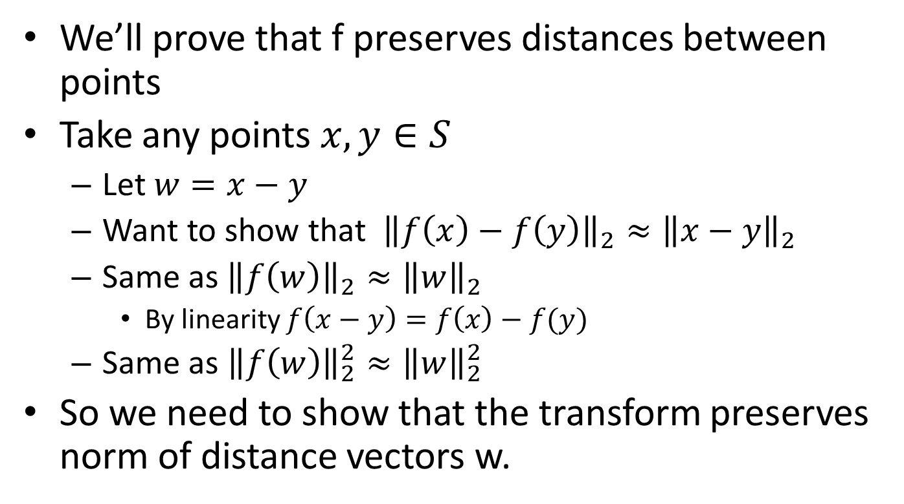
JL transform
We’ll prove that f preserves distances between points
Take any points $x,y∈S$
Let $w=x−y$
Want to show that ${\left\|f\left(x\right)−f\left(y\right)\right\|}_{2}≈{\left\|x−y\right\|}_{2}$
Same as${\left\|f\left(w\right)\right\|}_{2}≈{\left\|w\right\|}_{2}$
By linearity $f\left(x−y\right)=f\left(x\right)−f(y)$
Same as ${\left\|f\left(w\right)\right\|}_{2}^{2}≈{\left\|w\right\|}_{2}^{2}$
So we need to show that the transform preserves norm of distance vectors w.

Slide 8
JL transform
We need to show that the transform preserves norm of distance vectors w.
Let’s start with a matrix F that’s just a column vector
w
F
f(w)
-1
1
1
-1
(8, 1, 6, 3)
= (-4)

Slide 9
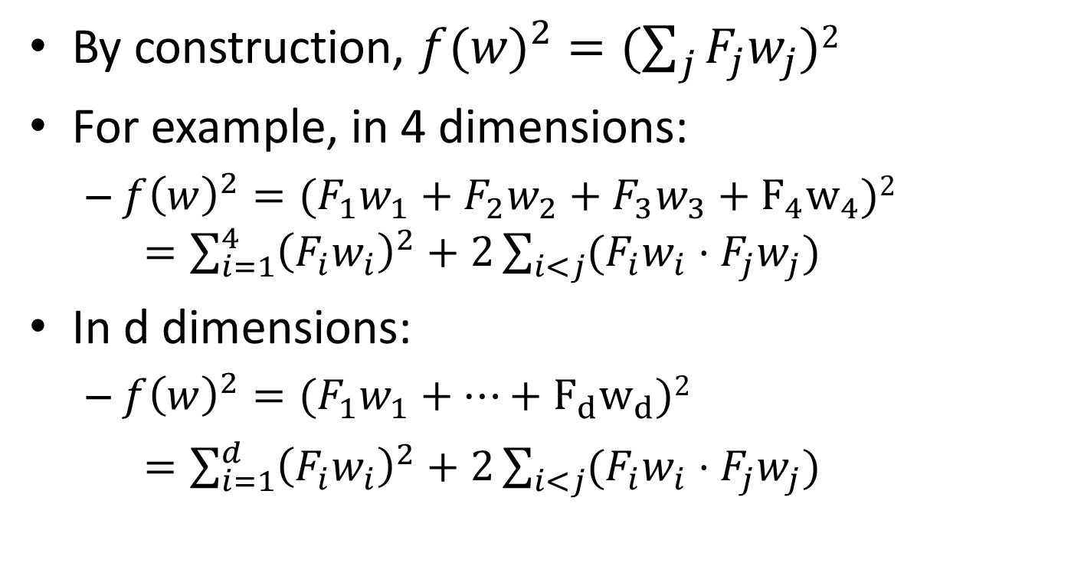
JL transform
By construction, ${f(w)}_{}^{2}=(\sum_{j}{F_{j}w_{j})2}$
For example, in 4 dimensions:
$f{\left(w\right)}^{2}={(F}_{1}w_{1}+F_{2}w_{2}+F_{3}w_{3}+F_{4}w_{4})2$ $=\sum_{i=1}^{4}{{\left(F_{i}w_{i}\right)}^{2}+2\sum_{i<j}{(F_{i}w_{i}⋅F_{j}w_{j})}}$
In d dimensions:
$f{\left(w\right)}^{2}={(F}_{1}w_{1}+…+F_{d}w_{d})2$
$=\sum_{i=1}^{d}{{\left(F_{i}w_{i}\right)}^{2}+2\sum_{i<j}{(F_{i}w_{i}⋅F_{j}w_{j})}}$

Slide 10
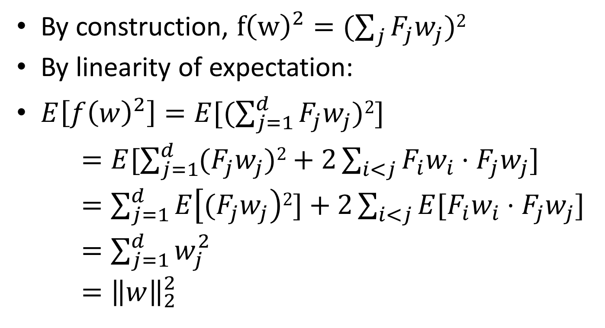
JL transform
By construction, $f{\left(w\right)}^{2}=(\sum_{j}{F_{j}w_{j})2}$
By linearity of expectation:
$E\left[f{\left(w\right)}^{2}\right]=E[(\sum_{j=1}^{d}{F_{j}w_{j})2]}$
$=E[\sum_{j=1}^{d}{{(F}_{j}w_{j})2+2\sum_{i<j}{F_{i}w_{i}⋅F_{j}w_{j}}]}$
$=\sum_{j=1}^{d}{E\left[{(F}_{j}w_{j}\right)2]+2\sum_{i<j}{{E[F}_{i}w_{i}⋅F_{j}w_{j}}]}$
$=\sum_{j=1}^{d}{w_{j}^{2}}$
$={\left\|w\right\|}_{2}^{2}$
F_{j}²=1
E[F_{i}F_{j}]=0

Slide 11
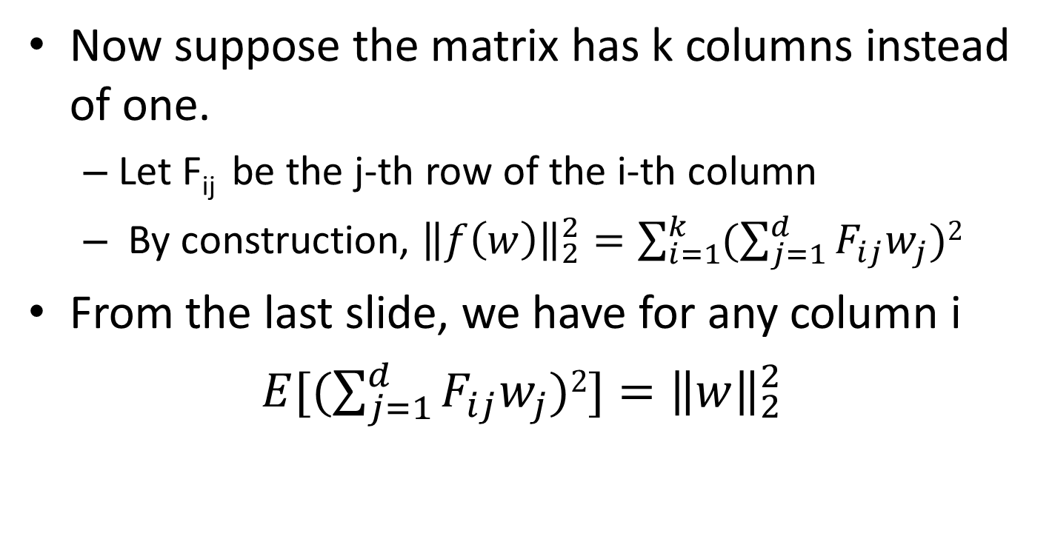
JL transform
Now suppose the matrix has k columns instead of one.
Let F_{ij} be the j-th row of the i-th column
By construction, ${\left\|f\left(w\right)\right\|}_{2}^{2}=\sum_{i=1}^{k}{(\sum_{j=1}^{d}{F_{ij}w_{j})2}}$
From the last slide, we have for any column i
$E[(\sum_{j=1}^{d}{F_{ij}w_{j})2]}={\left\|w\right\|}_{2}^{2}$
w
F
f(w)
-1 | 1
1 | -1
1 | 1
-1 | 1
(8, 1, 6, 3)
= (-4, 16)

Slide 12
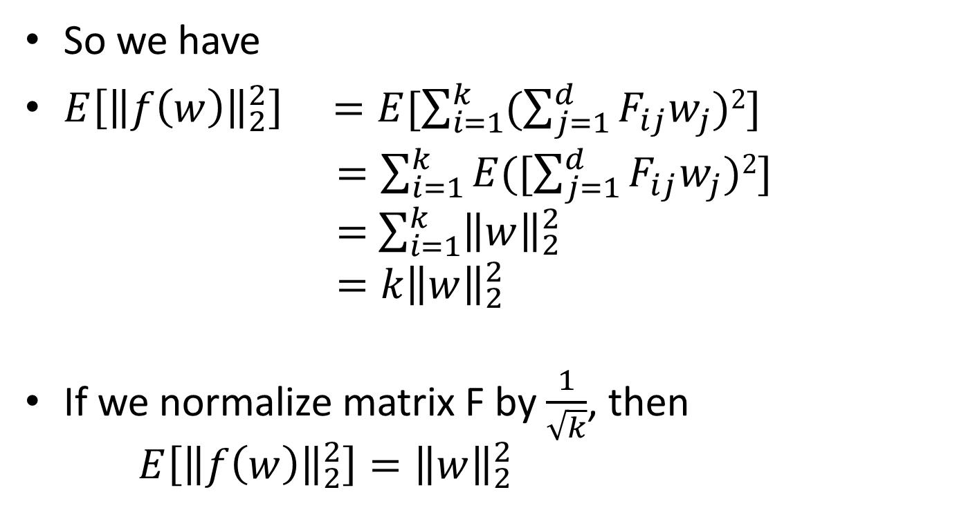
JL transform
So we have
$E\left[{\left\|f\left(w\right)\right\|}_{2}^{2}\right] =E[\sum_{i=1}^{k}{(\sum_{j=1}^{d}{F_{ij}w_{j})2}}]$
$=\sum_{i=1}^{k}{E([\sum_{j=1}^{d}{F_{ij}w_{j})2}}]$
$=$ $\sum_{i=1}^{k}{{\left\|w\right\|}_{2}^{2}}$
$=k{\left\|w\right\|}_{2}^{2}$
If we normalize matrix F by $\frac{1}{\sqrt{k}}$, then
$E\left[{\left\|f\left(w\right)\right\|}_{2}^{2}\right]={\left\|w\right\|}_{2}^{2}$

Slide 13
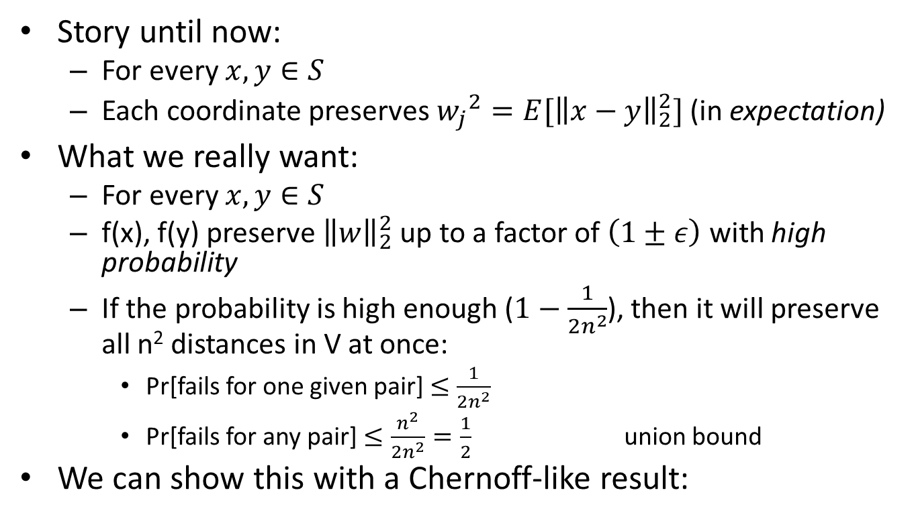
JL transform
Story until now:
For every $x,y∈S$
Each coordinate preserves ${w_{j}}_{}^{2}={E[\left\|x−y\right\|}_{2}^{2}]$ (in expectation)
What we really want:
For every $x,y∈S$
f(x), f(y) preserve ${\left\|w\right\|}_{2}^{2}$ up to a factor of $\left(1±ε\right)$ with high probability
If the probability is high enough ($1−\frac{1}{{2n}^{2}}$), then it will preserve all n² distances in V at once:
Pr[fails for one given pair] $≤\frac{1}{{2n}^{2}}$
Pr[fails for any pair] $≤\frac{n^{2}}{{2n}^{2}}=\frac{1}{2}$ union bound
We can show this with a Chernoff-like result:

Slide 14
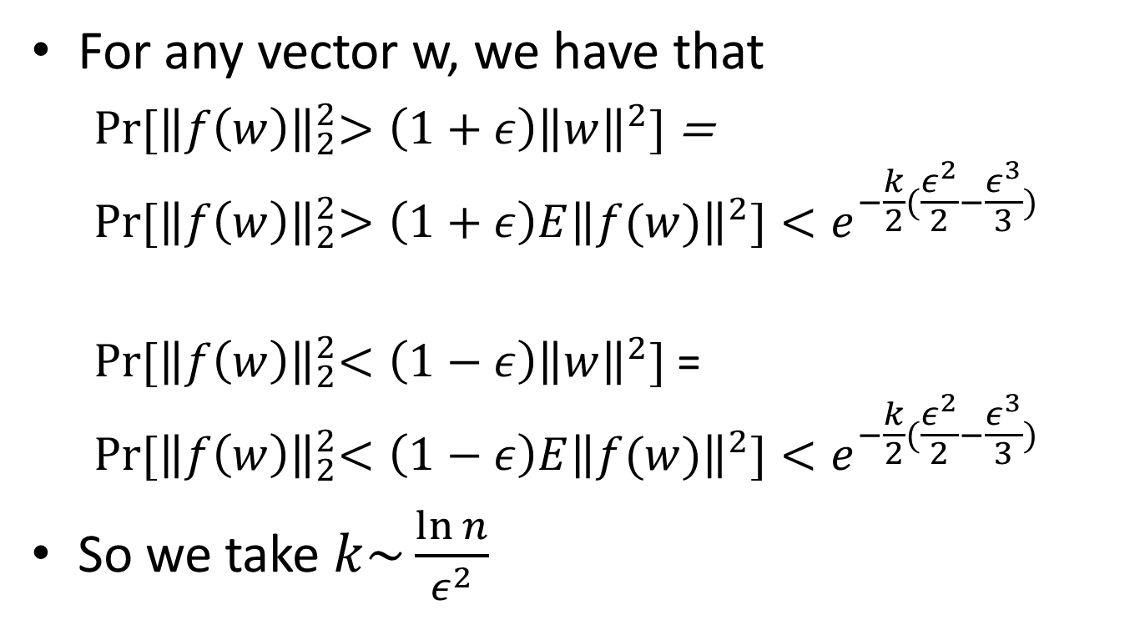
JL transform
For any vector w, we have that
$\operatorname{Pr}{{[\left\|f\left(w\right)\right\|}_{2}^{2}>\left(1+ε\right){\left\|w\right\|}^{2}]}$ =
$$\operatorname{Pr}{{[\left\|f\left(w\right)\right\|}_{2}^{2}>\left(1+ε\right)E{\left\|f(w)\right\|}^{2}]}<e^{−\frac{k}{2}(\frac{ε^{2}}{2}−\frac{ε^{3}}{3})}$$
$\operatorname{Pr}{{[\left\|f\left(w\right)\right\|}_{2}^{2}<\left(1−ε\right){\left\|w\right\|}^{2}]}$ =
$$\operatorname{Pr}{{[\left\|f\left(w\right)\right\|}_{2}^{2}<\left(1−ε\right)E{\left\|f(w)\right\|}^{2}]}<e^{−\frac{k}{2}(\frac{ε^{2}}{2}−\frac{ε^{3}}{3})}$$
So we take $k\sim \frac{\ln{n}}{ε^{2}}$

Slide 15
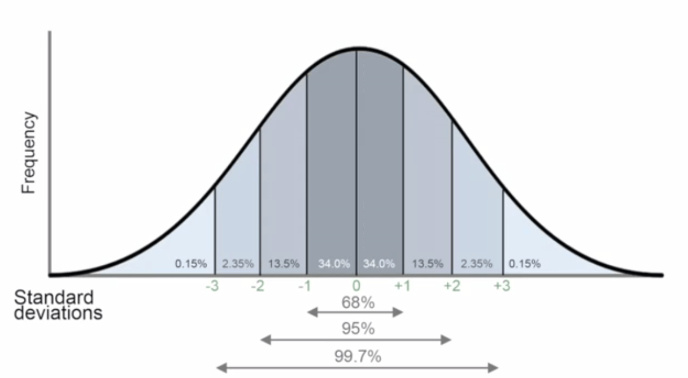
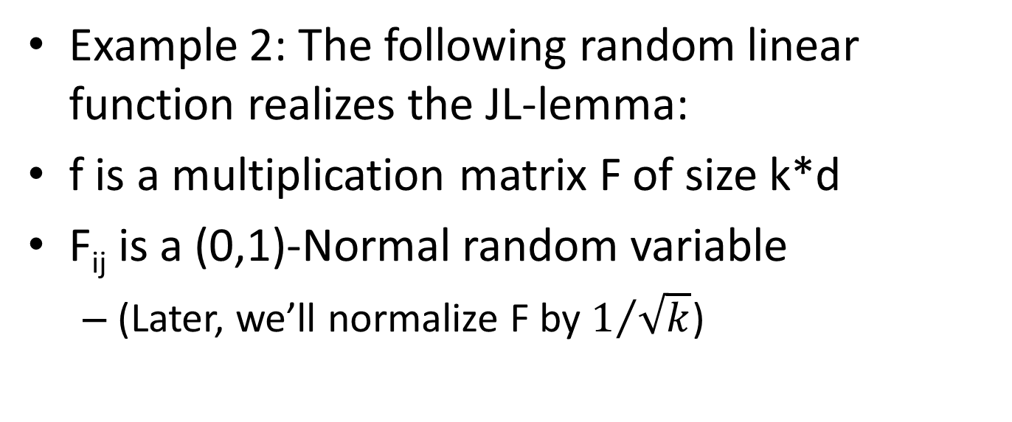
JL transform
Example 2: The following random linear function realizes the JL-lemma:
f is a multiplication matrix F of size k*d
F_{ij} is a (0,1)-Normal random variable
(Later, we’ll normalize F by $1/{\sqrt{k}}$)
x
F
f(x)
x
F
f(x)
N(0,1) | N(0,1)
N(0,1) | N(0,1)
N(0,1) | N(0,1)
N(0,1) | N(0,1)
(8, 1, 6, 3)
= (?, ?)
(8, 1, 6, 3)
= (?, ?)

Slide 16
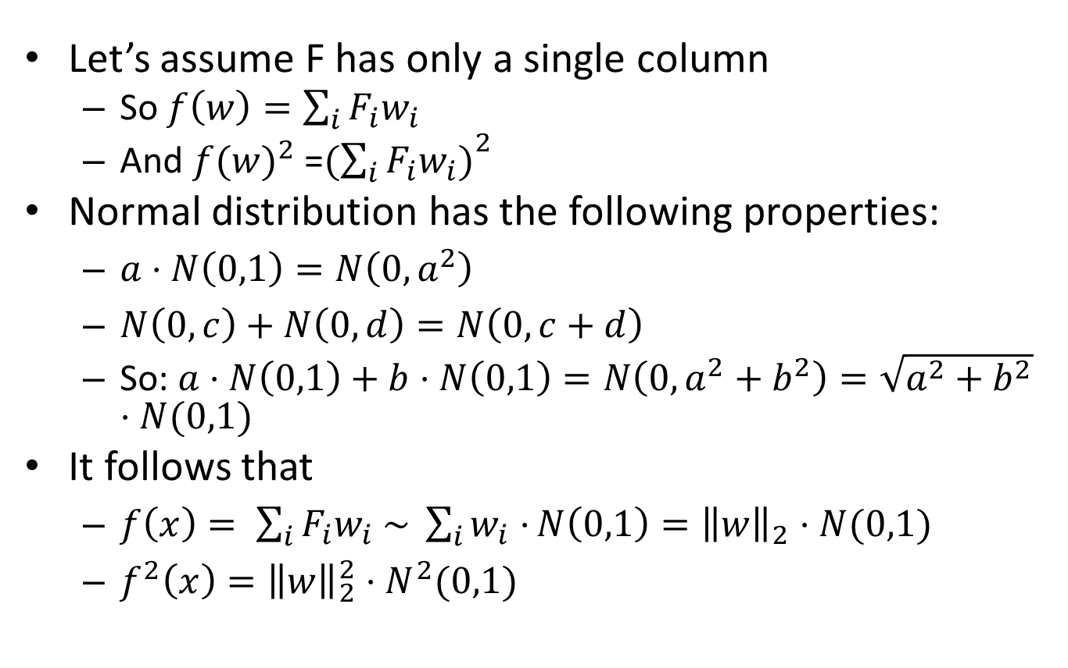
JL transform
Let’s assume F has only a single column
So $f\left(w\right)=\sum_{i}{F_{i}w_{i}}$
And ${f(w)}_{}^{2}$ =${(\sum_{i}{{F_{i}w}_{i})}}^{2}$
Normal distribution has the following properties:
$a⋅N\left(0,1\right)=N\left(0,a^{2}\right)$
$N\left(0,c\right)+N\left(0,d\right)=N\left(0,c+d\right)$
So: $a⋅N\left(0,1\right)+b⋅N\left(0,1\right)=N\left(0,a^{2}+b^{2}\right)=\sqrt{a^{2}+b^{2}}⋅N(0,1)$
It follows that
$f\left(x\right)= \sum_{i}{{F_{i}w}_{i} \sim \sum_{i}{w_{i}⋅}N\left(0,1\right)={\left\|w\right\|}_{2}⋅N(0,1)}$
$f^{2}\left(x\right)={\left\|w\right\|}_{2}^{2}⋅N^{2}(0,1)$

Slide 17
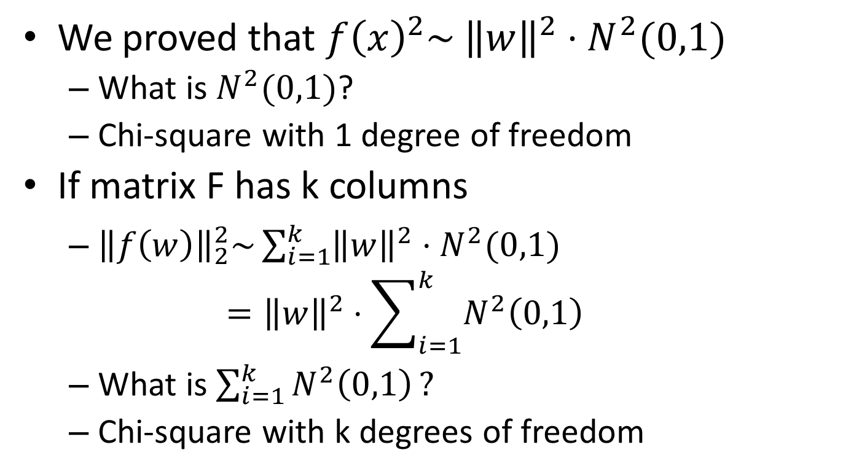
JL transform
We proved that $f{\left(x\right)}^{2}\sim {\left\|w\right\|}^{2}⋅N^{2}(0,1)$
What is $N^{2}(0,1)$?
Chi-square with 1 degree of freedom
If matrix F has k columns
${\left\|f\left(w\right)\right\|}_{2}^{2}\sim \sum_{i=1}^{k}{{\left\|w\right\|}^{2}⋅N^{2}(0,1) }$
$$={\left\|w\right\|}^{2}⋅\sum_{i=1}^{k}{N^{2}\left(0,1\right)}$$
What is $\sum_{i=1}^{k}{N^{2}\left(0,1\right)}?$
Chi-square with k degrees of freedom

Slide 18
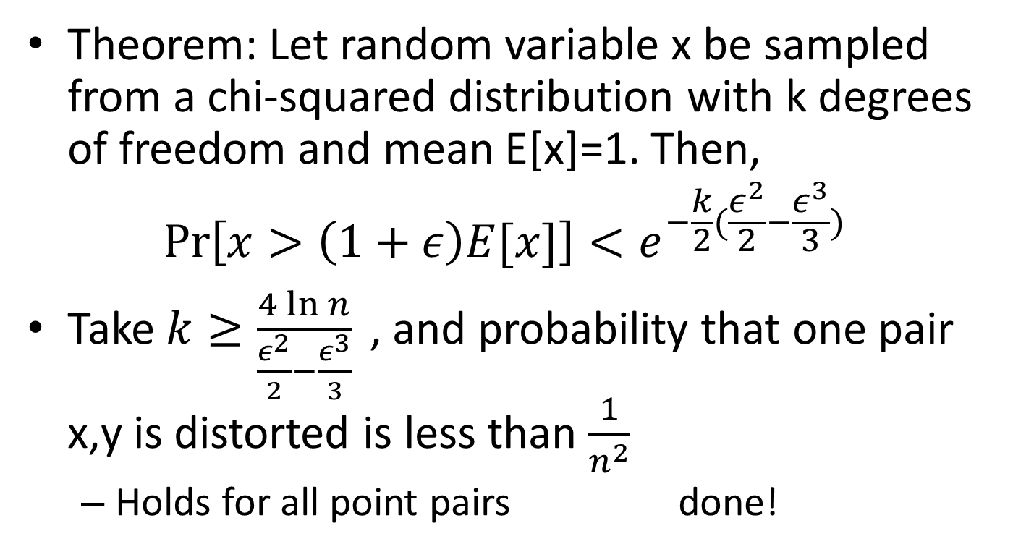
JL transform
Theorem: Let random variable x be sampled from a chi-squared distribution with k degrees of freedom and mean E[x]=1. Then,
$$\operatorname{Pr}\left[x>\left(1+ε\right)E[x]\right]<e^{−\frac{k}{2}(\frac{ε^{2}}{2}−\frac{ε^{3}}{3})}$$
Take $k≥\frac{4\ln{n}}{\frac{ε^{2}}{2}−\frac{ε^{3}}{3}}{ }$, and probability that one pair x,y is distorted is less than $\frac{1}{n^{2}}$
Holds for all point pairs done!

Slide 19
Johnson-Lindenstrauss into 1D
Measure:
Worst-case distortion

Slide 20
Johnson-Lindenstrauss into 2D
Measure:
Worst-case distortion

Slide 21

Lower-bound for JL
How many dimensions are necessary to achieve distortion $(1+ε)$?
Can we do better than $k=\frac{8\ln{n}}{ε^{2}}$?

Slide 22
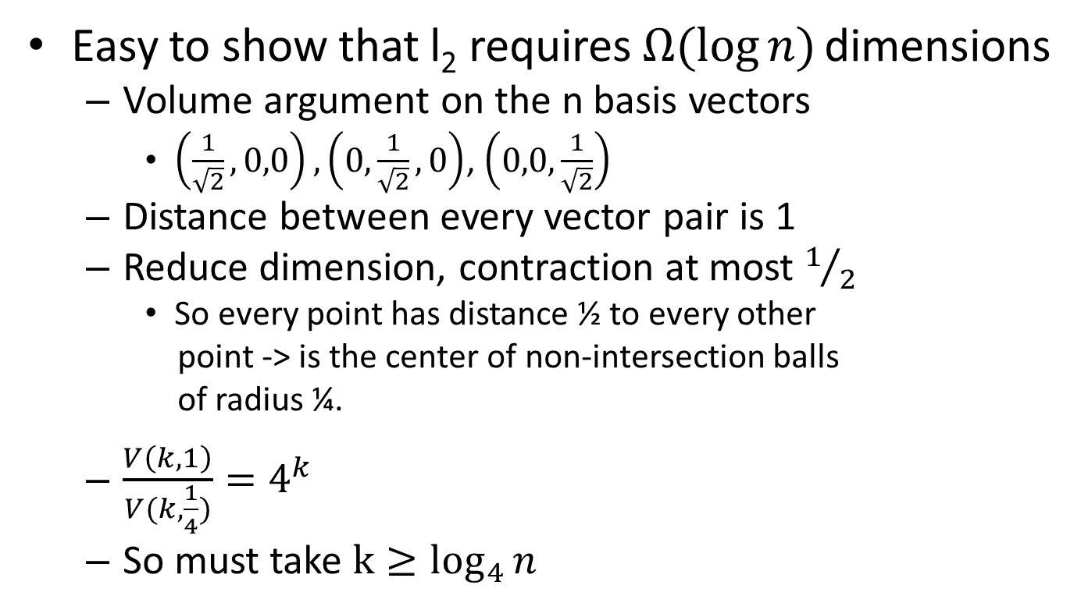
Lower-bound for JL
Easy to show that l₂ requires $Ω(log{n)}$ dimensions
Volume argument on the n basis vectors
$\left(\frac{1}{\sqrt{2}},0,0\right),\left(0,\frac{1}{\sqrt{2}},0\right)$, $\left(0,0,\frac{1}{\sqrt{2}}\right)$
Distance between every vector pair is 1
Reduce dimension, contraction at most $1/2$
So every point has distance ½ to every other
point -> is the center of non-intersection balls
of radius ¼.
$\frac{V\left(k,1\right)}{V(k,\frac{1}{4})}=4^{k}$
So must take ${k≥log}_{4}{n}$

Slide 23
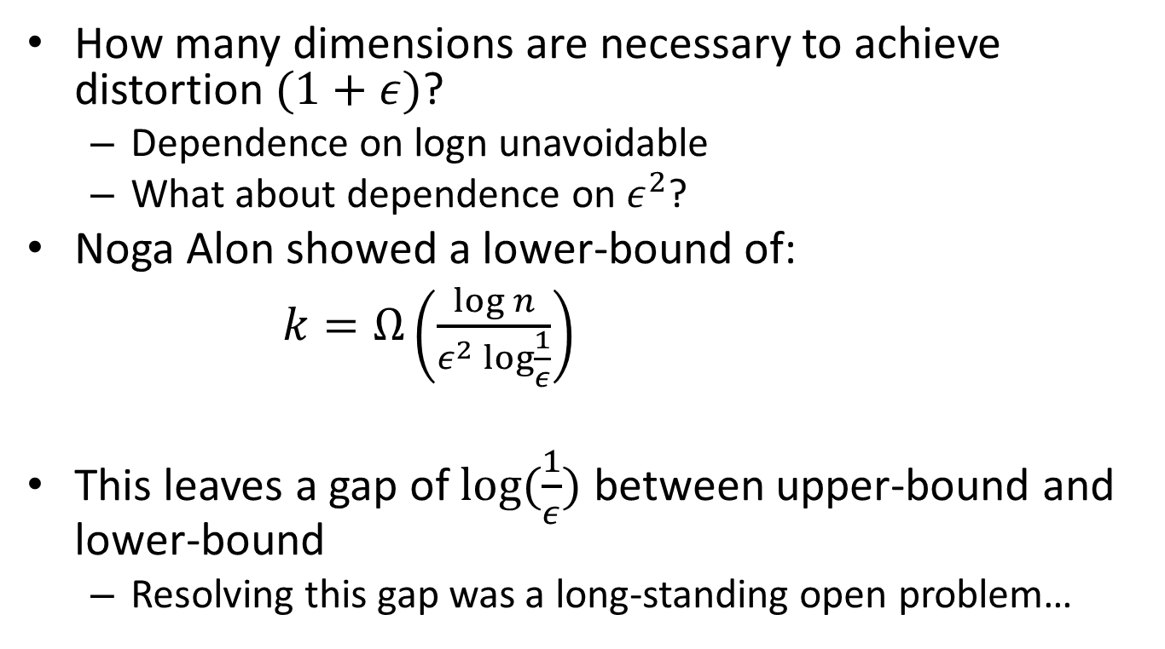
Lower-bound for JL
How many dimensions are necessary to achieve distortion $(1+ε)$?
Dependence on logn unavoidable
What about dependence on $ε^{2}$?
Noga Alon showed a lower-bound of:
$k=Ω\left(\frac{\log{n}}{ε^{2}\log{\frac{1}{ε}}}\right)$
This leaves a gap of $\log{(\frac{1}{ε})}$ between upper-bound and lower-bound
Resolving this gap was a long-standing open problem…

Slide 24
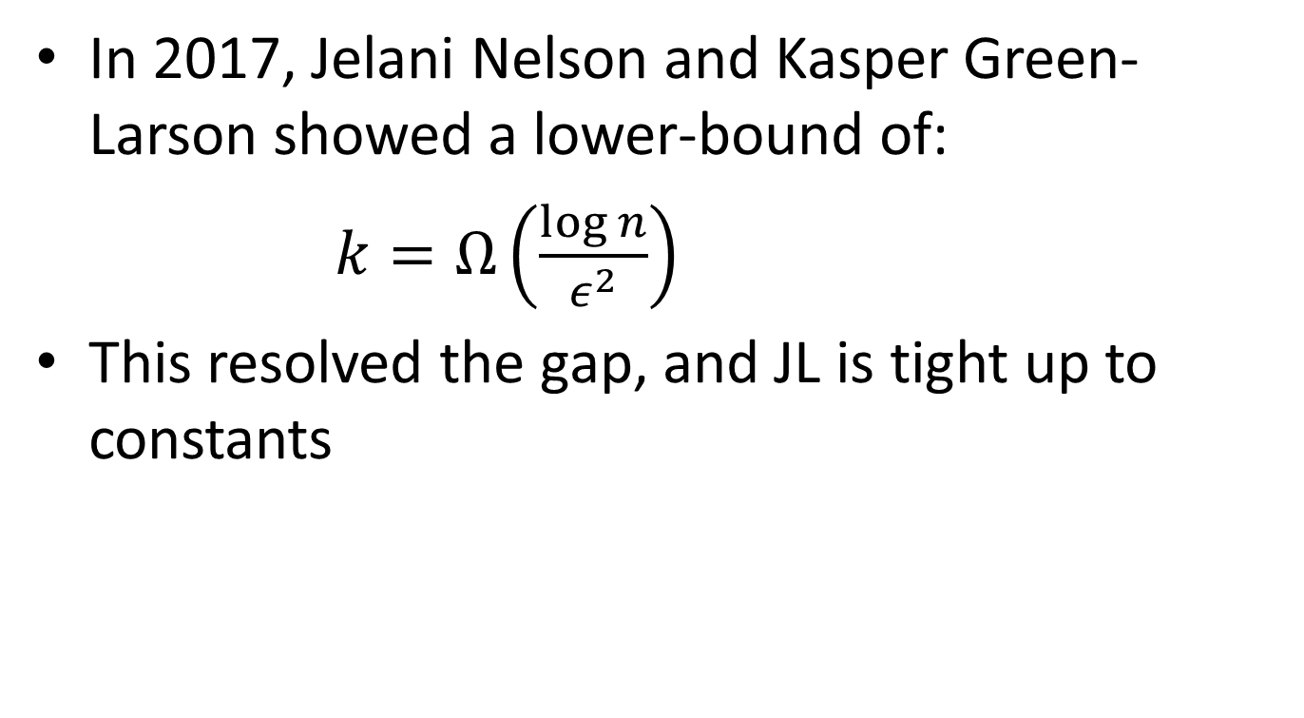
Lower-bound for JL
In 2017, Jelani Nelson and Kasper Green-Larson showed a lower-bound of:
$k=Ω\left(\frac{\log{n}}{ε^{2}}\right)$
This resolved the gap, and JL is tight up to constants

Slide 25
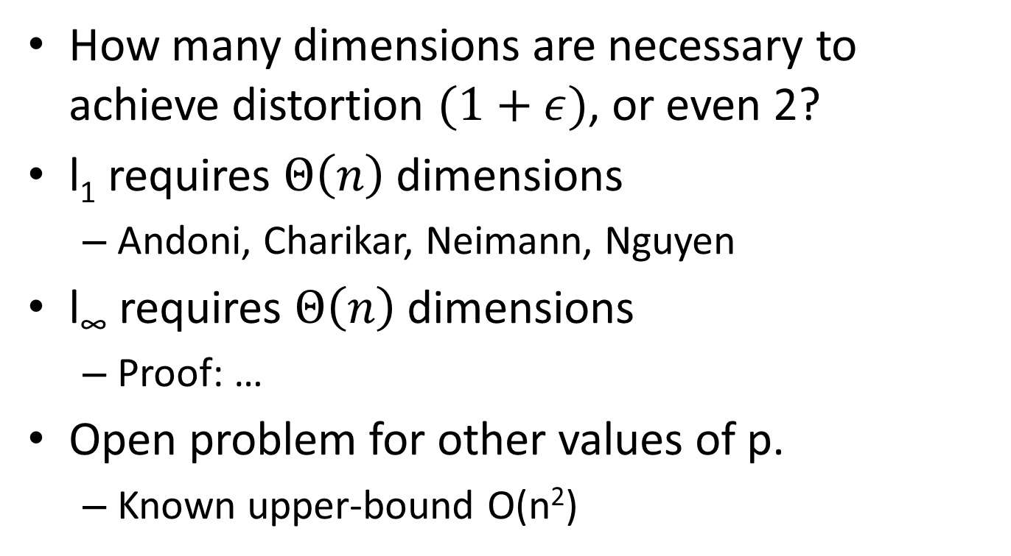
Lower-bounds for other l_{p}
How many dimensions are necessary to achieve distortion $(1+ε)$, or even 2?
l₁ requires $Θ\left(n\right)$dimensions
Andoni, Charikar, Neimann, Nguyen
l∞ requires $Θ\left(n\right)$dimensions
Proof: …
Open problem for other values of p.
Known upper-bound O(n²)

